Slide 1


HIRING PROCESS ANALYSIS
After analyzing the data provided in excel sheet , providing the necessary aspects used by the company for hiring.
The data includes the department in which employee is working , gender of the employee , salary of the employee , application_id , interview_time & their hiring status.
🡪SUMMIT TABHANE

Slide 2




OVERVIEW-
Tackling the problem provided with the help of different functions , commands & queries present in Microsoft Excel.
Sorting the data in the excel sheet and visualizing the data graphically to provide the required information.
Using various mathematical function to know the statistical information of data like mean, median, mode , max & min.
Turning raw data to insights.

Slide 3
HIRING ANALYSIS:-
Finding out the number of male & female involved in the hiring process.
Helps bringing new individual in the organization to new roles.
Can be found out by using countif function & selecting the row containing gender and providing the argument =“Male” & similarly for “Female”.
=COUNTIF(D2:D7169,"Male")

Slide 4
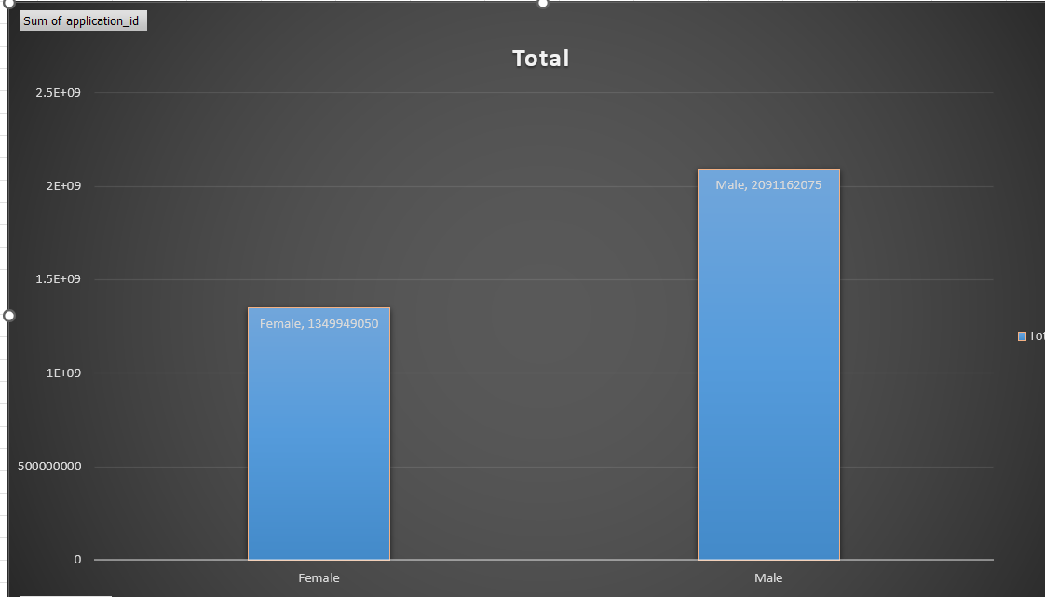
The same output can be done by inserting a slicer in the excel sheet which can filter the gender .
Then counting the number of rows in the data for male & female respectively.
Female
Male
Gender | Count
Male | 4085
Female | 2675

Slide 5

SALARY ANALYSIS:-
To find out the average salary of the employees of the company.
This allows to know the average earning of an employee which allow to know the spending of the company on their employees.
To know the average salary , we can use the in-built average function in the excel & choosing the salary row in the argument.
=AVERAGE(G2:G7169)
OUTPUT-49983.02902

Slide 6

SALARY DISTRIBUTION:-
Calculating the class interval of the salary of the employees.
This includes statistical functions like mean, median , mode & maximum , minimum of the salary provided
This can be found out by using mathematical functions provided in the excel such as
=average()
=max()
=median()
=min()
=mode()

Slide 7
OUTPUT OF SALARY DISTRIBUTION
4000
MAX 🡪 =MAX(G2:G7169) 🡪 Maximum salary
MIN 🡪 =MIN (G2:G7169 🡪 Minimum salary
MEAN 🡪=AVERAGE (G2:G7169) 🡪 Average salary
MEDIAN 🡪 = MEDIAN (G2:G7169) 🡪 ce Centralize salary
MODE 🡪 =MODE (G2:G7169) 🡪 Most occurring salary
100
49983.02
49625
72843

Slide 8

DEPARTMENTAL ANALYSIS:-
Visualizing the data with the help of charts like pie chart , bar chart.
Using the pivot table to plot graphs for the data provided in column department .
Insert the graphs from the ribbon by selecting the necessary graphs for the data .
Adding the department column from table .

Slide 9
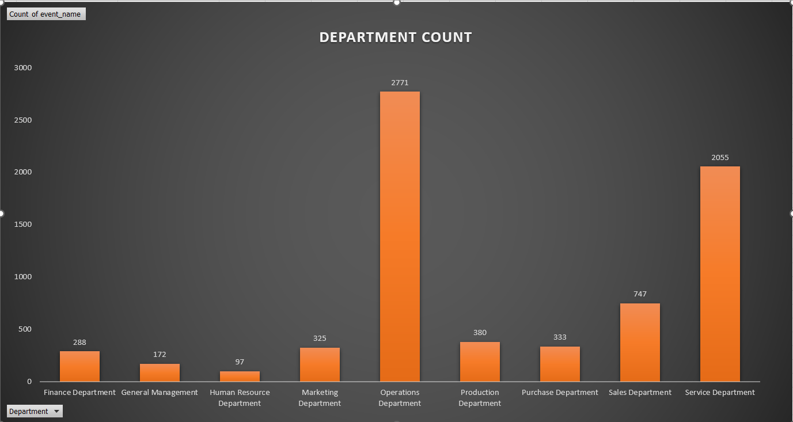
BAR CHART :-

Slide 10
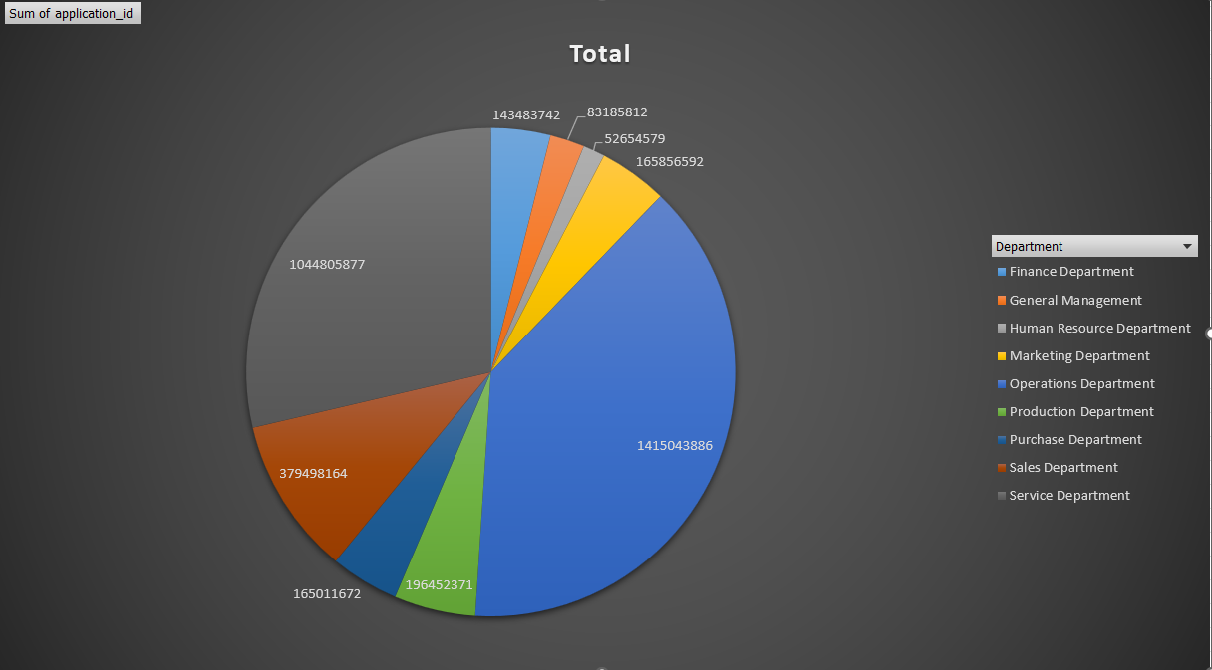
PIE CHART:-

Slide 11

POSITION TIER ANALYSIS:-
With the help of charts and graphs representing the different tiers of the company , helps to understand different tiers across the company.
Using department & position column of the table.
Using pivot table to plot graphs , using the department & position_id.

Slide 12
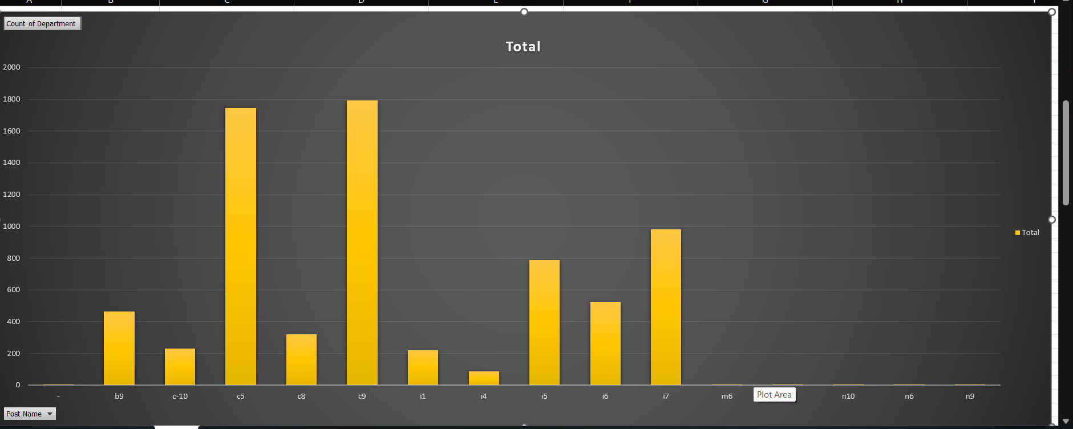
BAR CHART:-

Slide 13
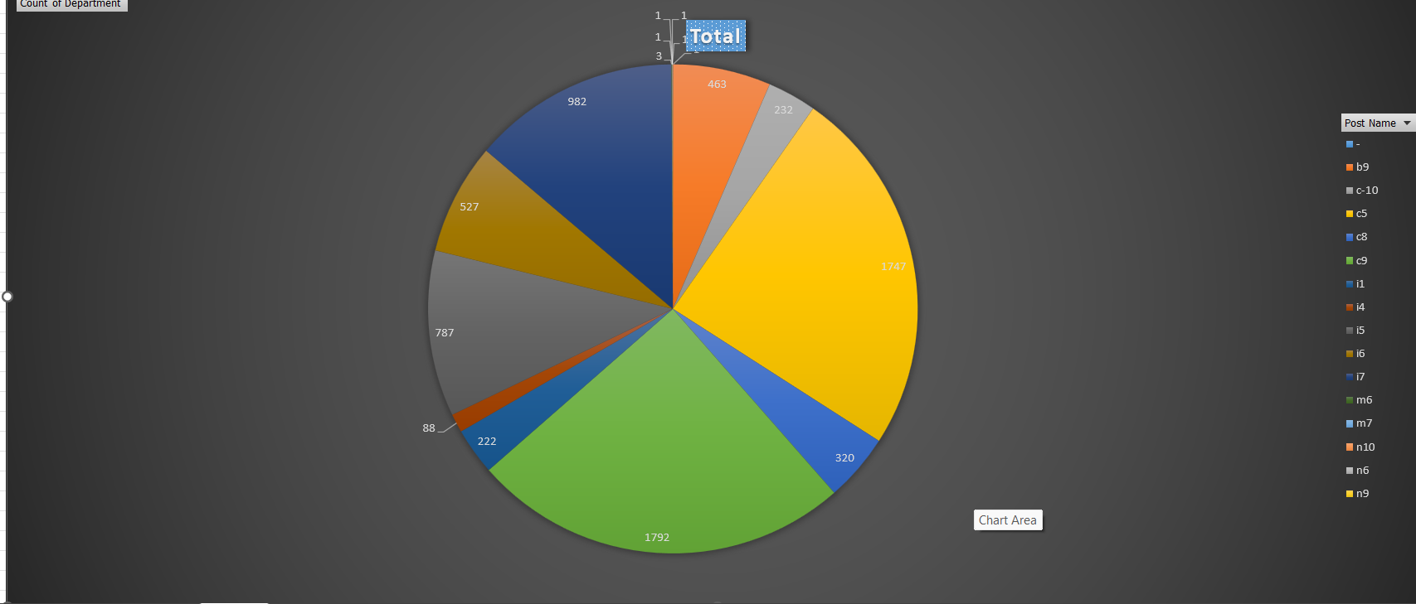
PIE CHART :-

Slide 14
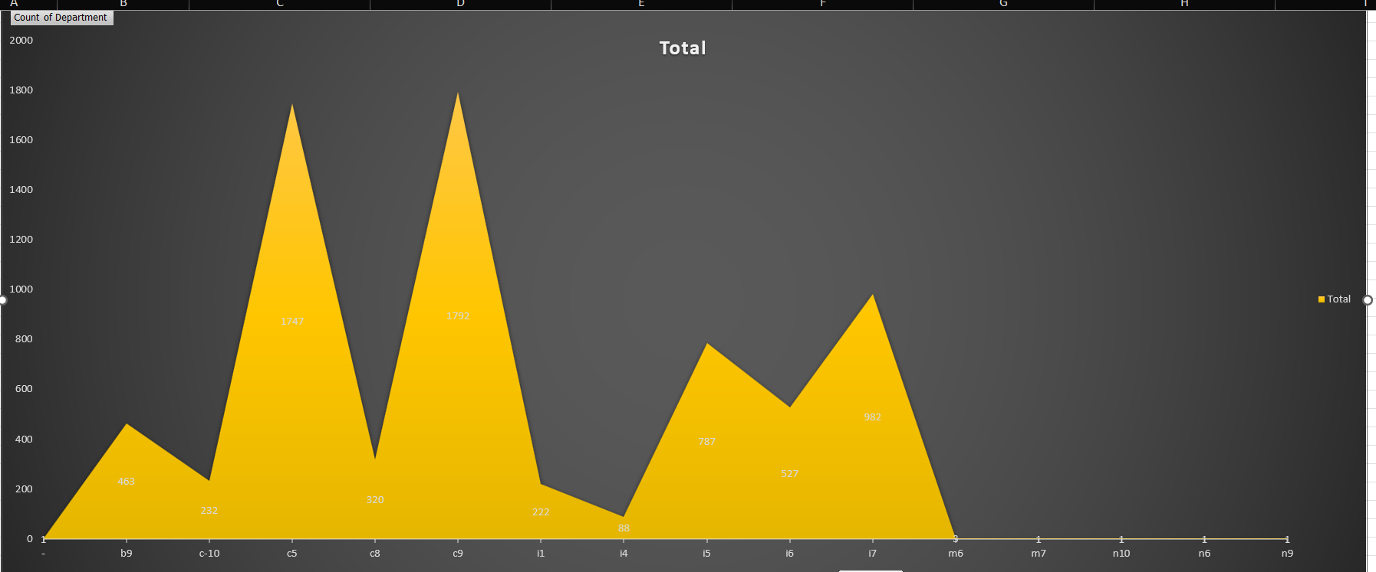
RADAR CHART:-

